Slide 1
Deep Learning Assignment 2 Problem 2
Vincent Tan Guan Shen S10227963

Slide 2
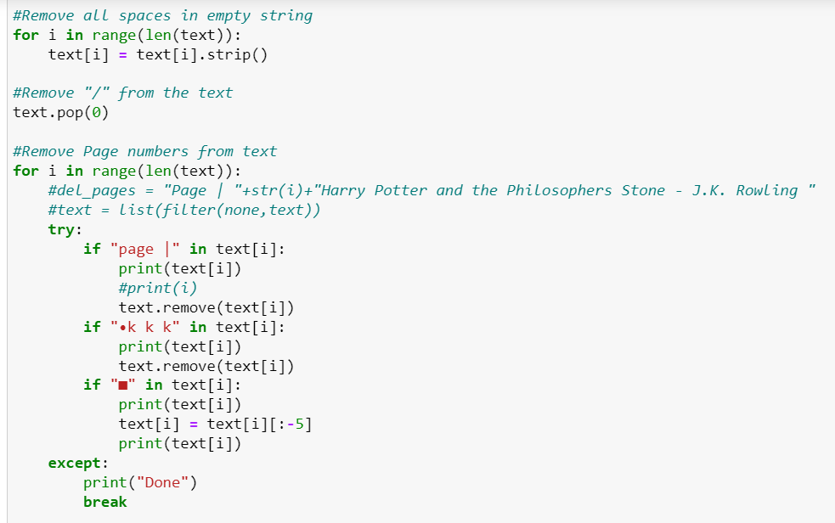
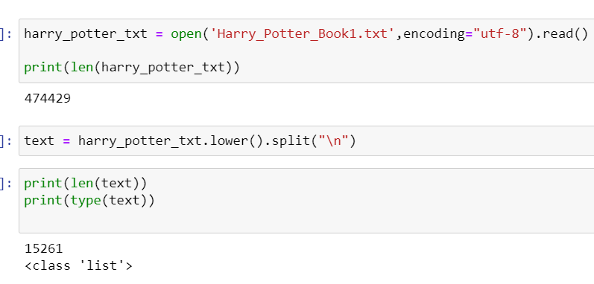

Data Processing

Slide 3

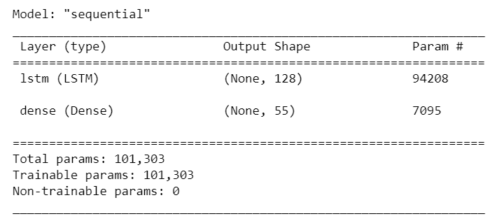
Model 1

Slide 4
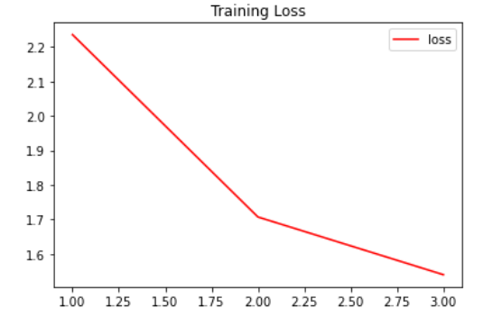
Model Accuracy

Slide 5
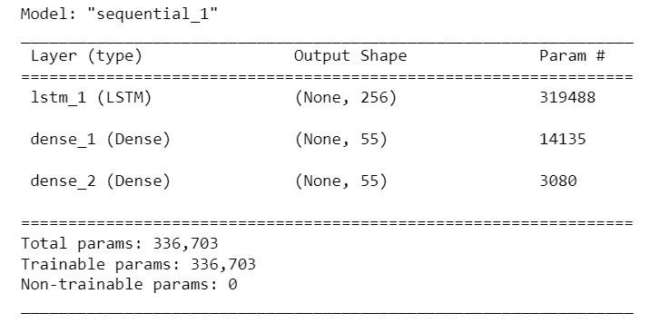


Model 2

Slide 6
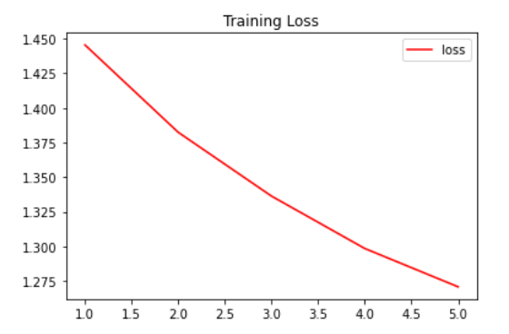
Model Accuracy

Slide 7
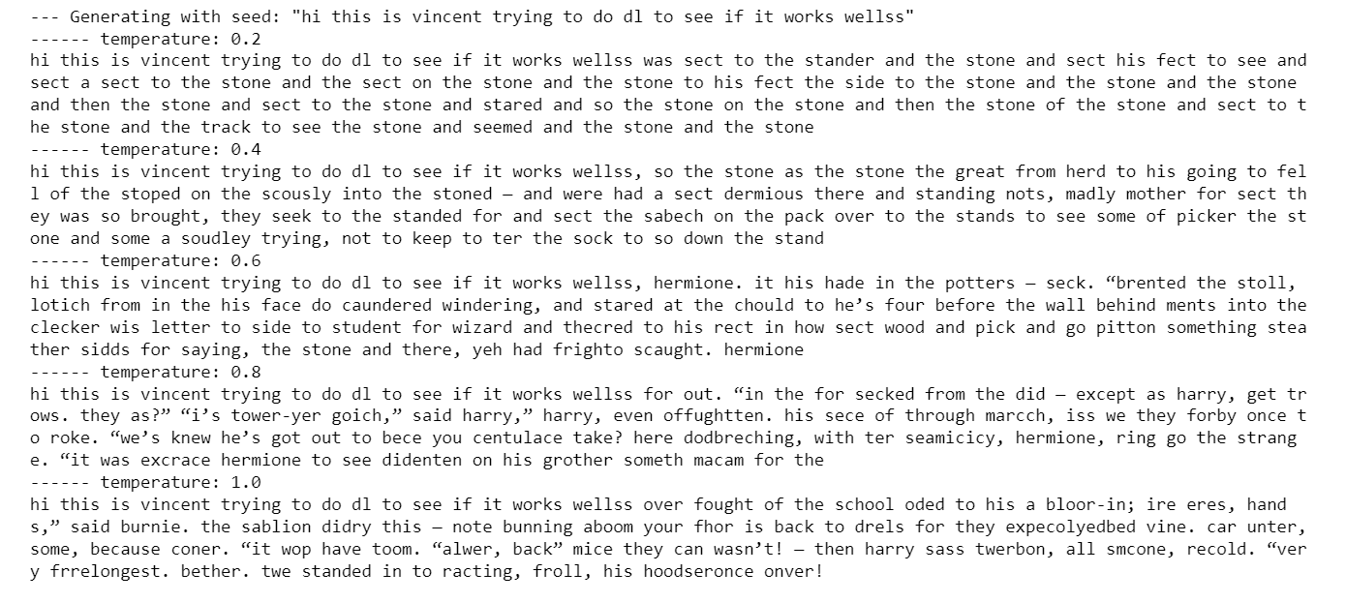
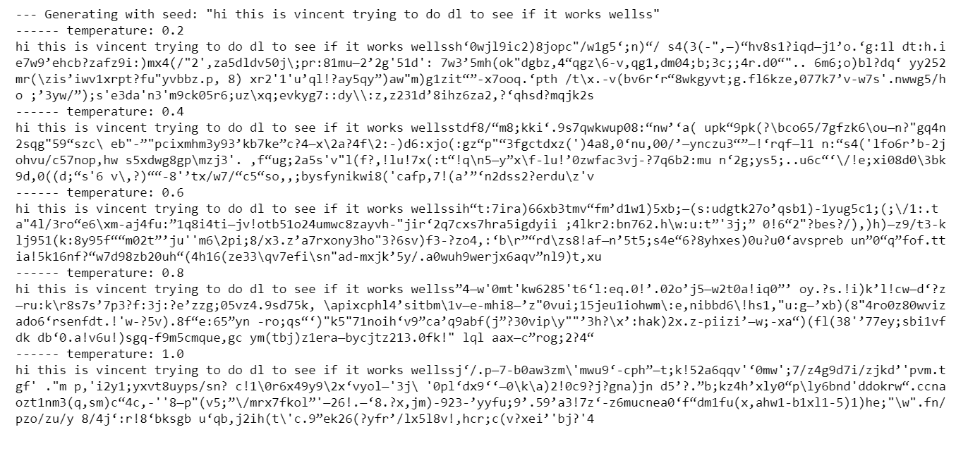
Generated Text
Model 2
Model 1

